Slide 1
Medical Laboratory Science Program

Slide 2
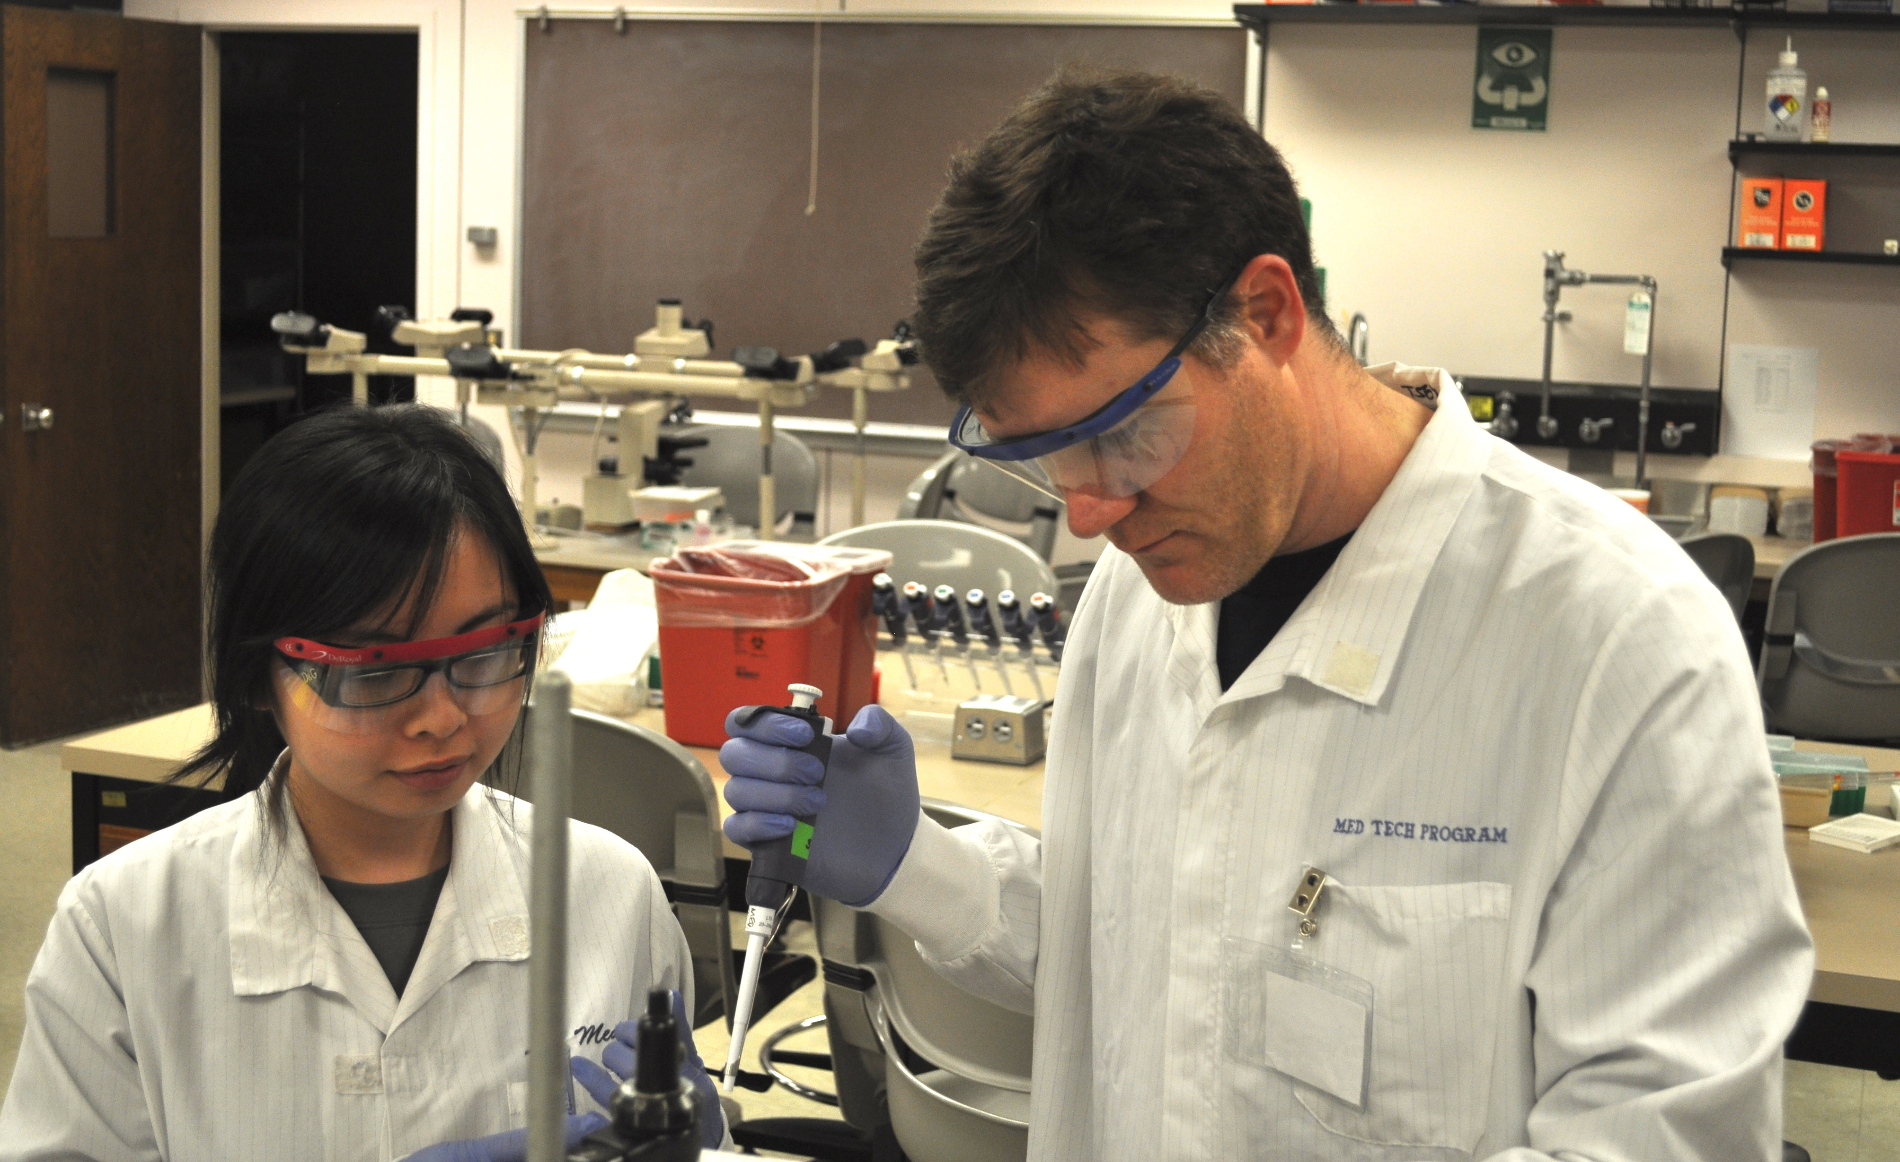
Medical Laboratory Scientists
Skills:
Integrate science, medicine, and technology
Daily Role:
Help clinicians diagnose and treat disease
Career:
Rewarding
Flexible
Team-oriented
Intellectually stimulating

Slide 3
What will my degree be worth?
UW Medicine System
MLS Trainee: $82,488-$107,892 per year.
There are 4 criteria Trainees need to meet to move to MLS and then you get promoted to…
MLS 1: $91,140-$111,192 per year
*Currently UW Med offering $3,000-$5,000
new hire bonuses*

Slide 4
Where do UW MLS graduates work?
Class of 2024: 26 of 34 employed as an MLS w/in 3 months of graduation.
Harborview Medical Center, Seattle – 4
Multicare, Tacoma General – 1
OHSU, Portland – 1
Overlake Medical Center, Bellevue – 1
PeaceHealth, Alaska – 1
Seattle Cancer Care Alliance (SCCA) - 1
Seattle Children’s Hospital – 4
UW Hematopathology @ SCCA - 1
UW Medical Center – Montlake – 11​
UW Medical Center – Northwest – 1

Slide 5
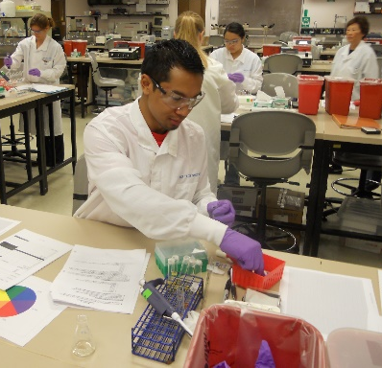
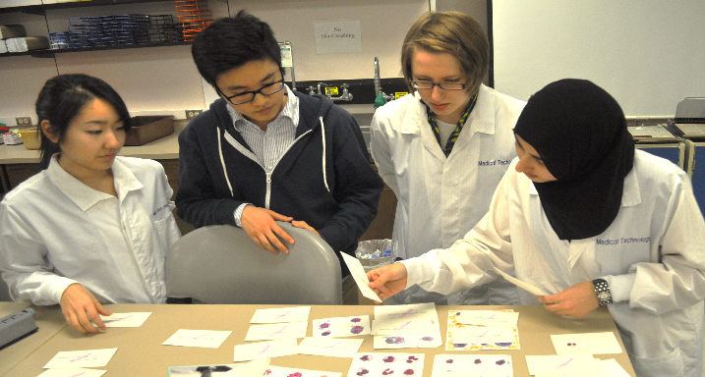
MLS Disciplines
Chemistry
Hematology/Coagulation
Microbiology
Transfusion Medicine
Immunology
Urinalysis
Molecular/Genetics
Laboratory Operations

Slide 6
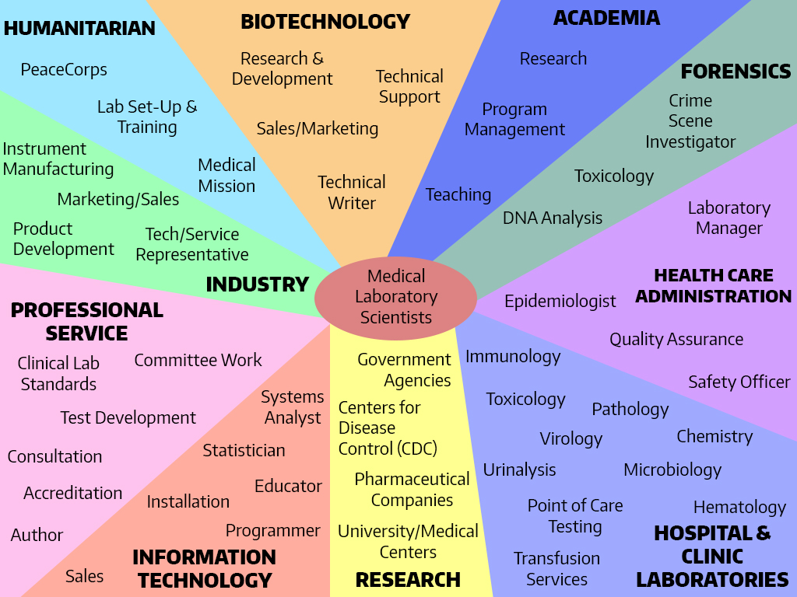

Slide 7
Bachelor of Science (B.S.) Program
2+2 Program
First two years:
Pre-Professional Phase
90 quarter credits of prerequisite and general education coursework
+
Final two years:
Professional Phase (6 consecutive quarters)
Didactic Courses (4 quarters) and Clinical Internships (2 quarters)
= 4-year B.S. degree

Slide 8
Pre-Professional Prerequisites
General Biology (BIOL 180, 200, 220)
General Chemistry (CHEM 142, 152, 162)
Organic Chemistry (CHEM 237 or 223): 1 quarter/lab NOT required
Statistics (any 5-credit quarter/3-credit semester course)
General Education Coursework* (req’d for graduation):
Composition
7 additional Writing (W) credits
10 Arts & Humanities, 10 Social Sciences, and 5 Diversity credits
Note: Take entire series at the same educational institution.
*General Education requirements DO NOT apply to Post-bacs.

Slide 9
Application Process
Note: All applicants must have completed a minimum of 90 quarter credits. Applicants must also have a minimum 2.5 cumulative AND science GPA.
Apply online by February 15th
Components:
Completed application form(s):
Postbaccalaureate and Transfer Students (includes UW-Tacoma/Bothell) must apply to UW-Seattle AND the MLS Program in two separate online applications.
Personal Statement (fit, experience, goals, etc.)
Unofficial Transcripts from ALL colleges/universities attended (including UW students). Official transcripts are required upon admission to the major.
One Recommendation Form
30-minute Interview* – typically in April
*(not all applicants receive an interview, but all admitted applicants will)

Slide 10
Frequently Asked Questions
What’s the average GPA of people who get in?
Students Admitted in 2024:
Admitted Cumm. GPA: 3.60
Range: 2.91-3.99
Admitted Science. GPA: 3.43
Range: 2.34-4.00
When do I have to complete my prerequisites?
Must be completed before entering the program, but can be in-progress during the application process.
How many people apply each year?
Year | Applied | Admitted
2022 | 96 | 35
2023 | 95 | 36
2024 | 93 | 36

Slide 11
MLS Program – First Year *SUBJECT TO CHANGE*
Autumn Quarter:
BIOC 405 Biochemistry
LABM 301/302 Intro. to MLS
IMMUN 441 Immunology
Winter Quarter:
LABM 430 Hematology
LABM 435 Molecular
Diagnostics
MICROM 442 Bacteriology
MICROM 443 Bacteriology
Lab
Spring Quarter:
MICROM 460 Mycology & Parasit
LABM 419 Coagulation
LABM 420 Urinalysis
LABM 421 Medical
Microbiology

Slide 12
MLS Program – Second Year *SUBJECT TO CHANGE*
Autumn Quarter:
LAB M 419 – Clinical Chemistry
LABM 426 – Transfusion Medicine
LABM 427 – Senior Seminar. The only non-science course in the program. Focus is career development.
Winter & Spring Clinical Rotations:
LABM 423 – Clinical Chemistry Rotation (5 weeks)
LABM 424 – Clinical Microbiology Rotation (5 weeks)
LABM 425 – Clinical Hematology Rotation (5 weeks)
LABM 431 – Transfusion Medicine Rotation (4 weeks)
LABM 436 – Molecular Diagnostics Rotation (1 week)
Notes:
We assign clinical rotations, which can take place all over the Puget Sound.
Some clinical rotation sites may require drug testing.

Slide 13
Tuition, Fees & Logistics
MLSP is 7 quarters in length (mandatory summer quarter between first and second year). Subject to change.
Full-time WA state resident students (2024-25) = $4,325 per quarter current UW undergrads, transfers and Postbacs
Full-time non-resident students (2024-25) = $14,403 per quarter current UW undergrads, transfers and Postbacs
UW determines resident and non-resident tuition, not the MLSP.
Additional tuition information available here.
No lab fees for the LABM Classes, but possibly for the MICROM classes.

Slide 14
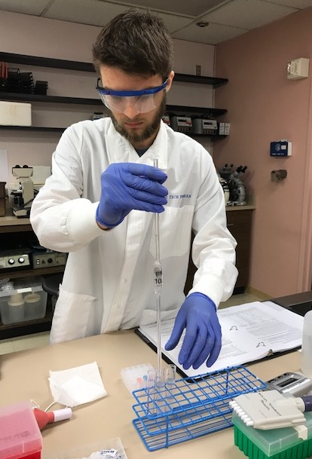
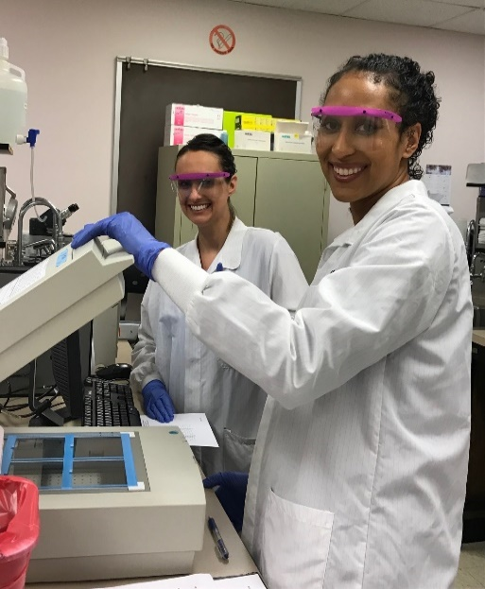
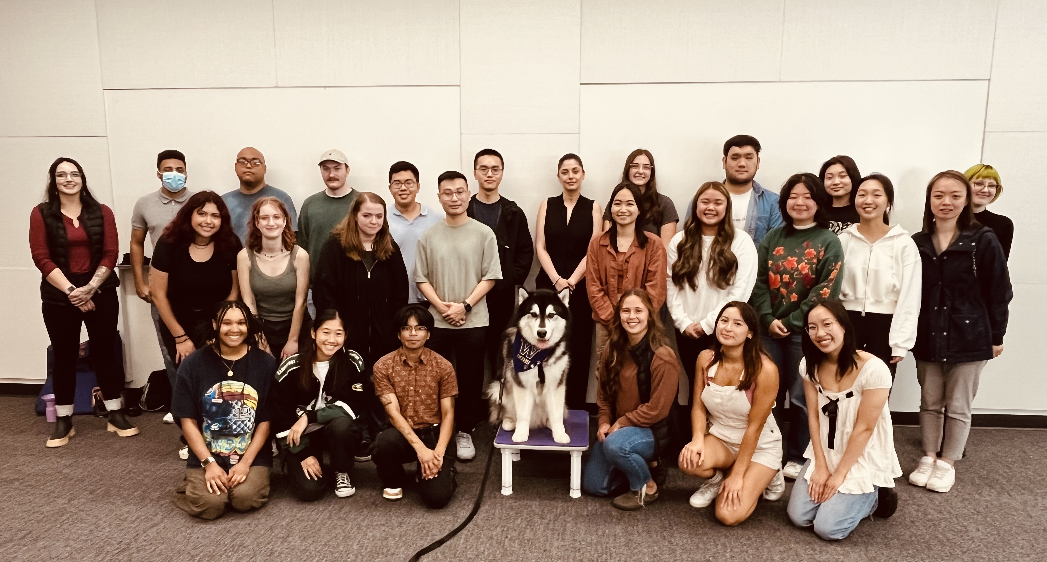
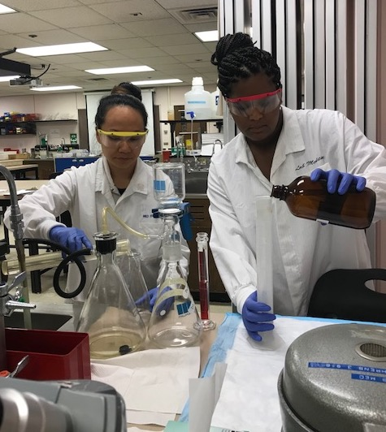
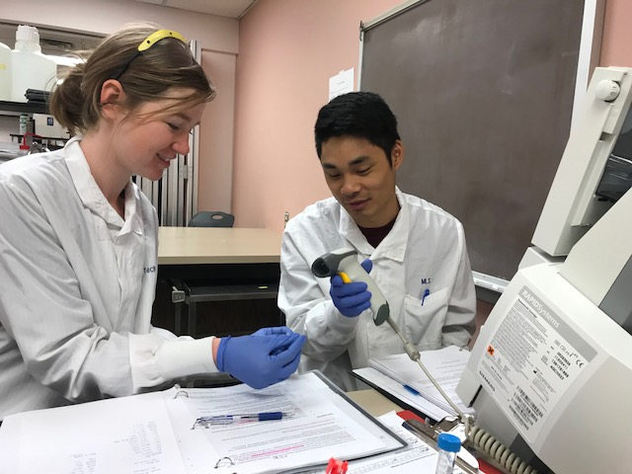
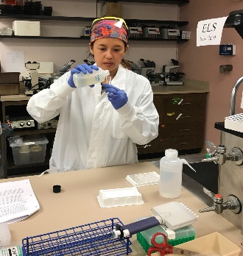
Student Lab

Slide 15
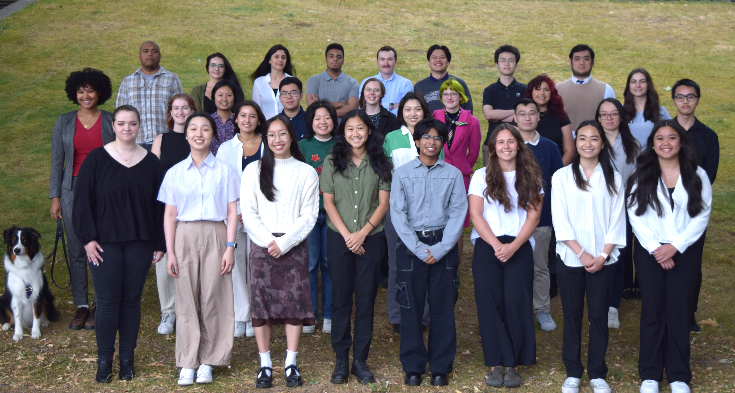
Congratulations Class of 2025!

Slide 16
Contact Us
Please feel free to reach out if you have questions or want to schedule an in-person or online advising appointment!
Email: medtech@uw.edu
Website and Application: https://dlmp.uw.edu/education/mls-undergrad
Location: UW Medical Center – Montlake, NW 120

