Slide 1
Pathology Department-wide IRB protocol to enable screening of electronic medical records for research purposes
IRB protocol no. 2837
PI: Dr. David F. Chhieng
Regulatory Manager: Erica Jonlin

Slide 2
Screening medical records and pathology slides for research purposes
You likely review patient records all the time, e.g.,
PowerPath, EPIC, etc.
Pathology slides
But if you want to review these records and materials for a RESEARCH study (not for clinical care), you must fulfill several requirements:
First obtain permission from the UW Institutional Review Board (IRB) IRB = a committee which reviews all research at the UW that involves human subjects, including research that accesses medical records and human specimens (IRB review is a Federal requirement) | The Dept. of Pathology has obtained approval of a “blanket IRB application.” If you are covered under this approval (see the next few slides), you may not have to do your own IRB application!
After screening the records/slides, report to UW Compliance which patient records you looked at (this is a HIPAA requirement). | Even if you qualify for the blanket IRB approval, you must do the HIPAA-required reporting!

Slide 3
Pathology Department Approved Umbrella or “Blanket IRB”
PURPOSE:
Enables Pathology Department members to:
screen electronic medical records (primarily the Department database, PowerPath, but also EPIC, other UW medical records) and, if necessary,
view archival histology and cytology slides for research purposes
Activities which may be conducted under this blanket IRB application include:
1) Conducting a records review study, or
2) Determining feasibility for a future study (for example, whether there are enough patients), or
3) Establishing a study dataset for a future study of both records and specimens.

Slide 4
UMBRELLA/Blanket IRB APPLICATION
Screen PowerPath to identify patients
Pick eligible cases
Look at the archived slides
Analysis and/or
Use this information to plan a future study

Slide 5
You are covered by the blanket IRB application if:
Your study is “unfunded” (i.e., there are no external grants specifically funding the research)
Internal, departmental funds are okay.
Your study is RETROSPECTIVE
You are looking at existing records and specimens/slides
You DO NOT have a Financial Conflict of Interest with respect to the research
You signed the Letter of Agreement to do HIPAA reporting for this study, IRB protocol no. 2837
NOTE: You will need to sign it EVERY YEAR

Slide 6
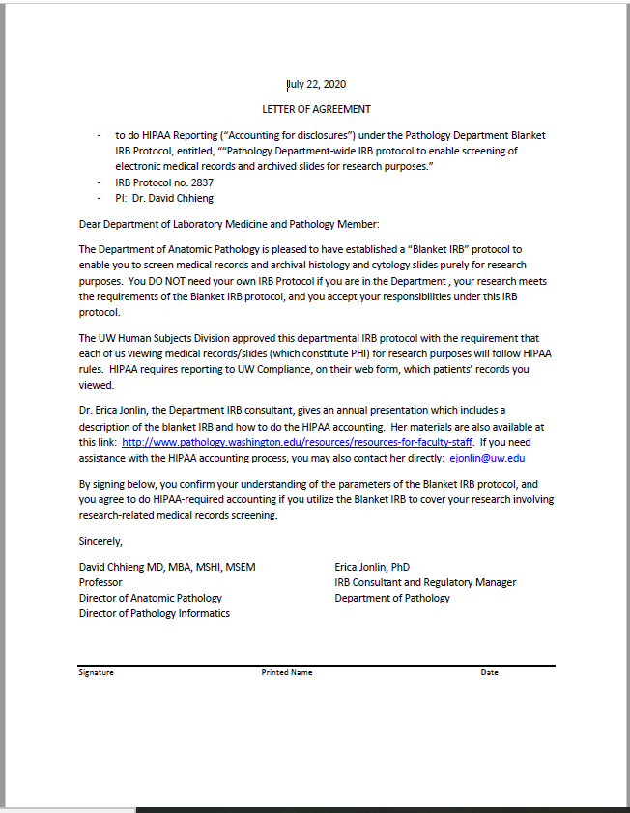
Letter of Agreement: Your promise to do HIPAA accounting Obtain the letter from Erica Jonlin ejonlin@uw.edu

Slide 7
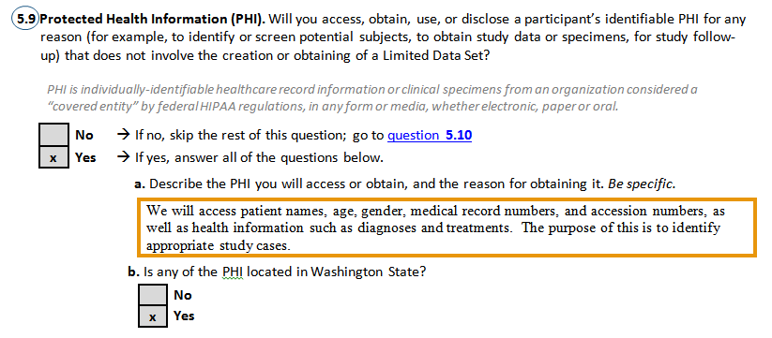
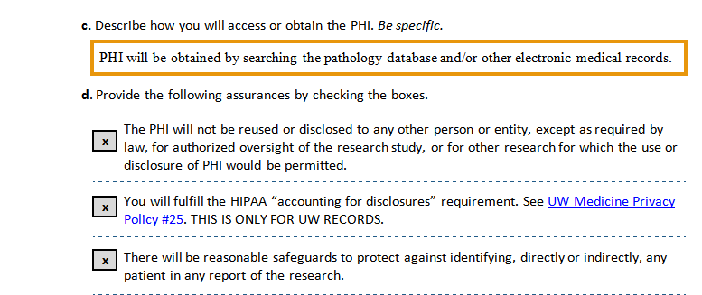
WHAT YOU AGREED TO BY SIGNING THE FORM
From the IRB protocol:

Slide 8
Here are the instructions for how to do the HIPAA-required reporting
By signing the Department’s Blanket IRB Letter of Agreement,
You are an investigator on this IRB application AND
YOU HAVE ALSO PROMISED TO REPORT TO UW COMPLIANCE WHICH PATIENT RECORDS YOU LOOKED AT FOR RESEARCH PURPOSES
(HIPAA requirement)

Slide 9
Searching medical records and reporting which patient records you reviewed
Do your search (typically PowerPath, but also applies to any electronic medical records in our system)
Get your list of patient numbers
Fill out the UW Medicine HIPAA Compliance Excel spreadsheet (detailed instructions on next two pages)
Save the Excel spreadsheet with a name like this: “yournetIDdateofsearch” - for example: ejonlin22Feb2020

Slide 10
Uploading your list of viewed patient records
Log into the UW Medicine SSLVPN with AMC login credentials: https://sslvpn.medical.washington.edu/dana-na/auth/url_9/welcome.cgi
Add the disclosure accounting website link to the Web Bookmarks after logging in: https://disclosureaccounting.uwmedicine.org/
3) Upload your Excel spreadsheet to the disclosure accounting website
4) Also send the Excel spreadsheet to PI, David C Chhieng: dchhieng@uw.edu
and Erica Jonlin: ejonlin@uw.edu

Slide 11
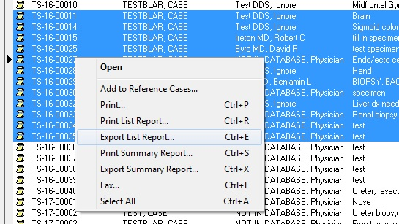
How to Export a search from PowerPath
Right-click and select the “Export list report…” option.

Slide 12
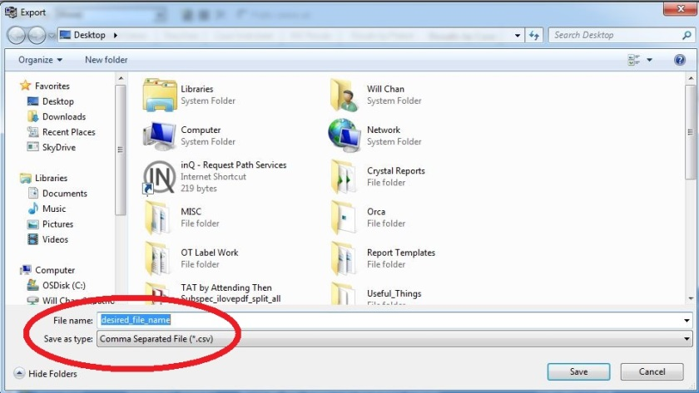
How to Export a search from PowerPath (cont.)
In the Save-As window, check to see that the .csv format is selected after you’ve named your file as desired.

Slide 13
UW Medicine Compliance Form to fill out after you do a PowerPath search
*
Your name
Your address
**
Leave these BLANK
Your email
Leave these BLANK
Date you did the search
Ex: DOB, diagnosis code; note 600 character limit
Your phone no.
Copy and paste this exact same information in every row for which you have a patient no. in Column A
* Fill in each and every patient number that came up in your search, one per row.
Each patient number will start with U, H, N, or Z, and will be followed by 7 digits.
** Write: “UW IRB no. 2837, Path Dept-wide IRB to enable screening of EMRs for research purposes”

Slide 14
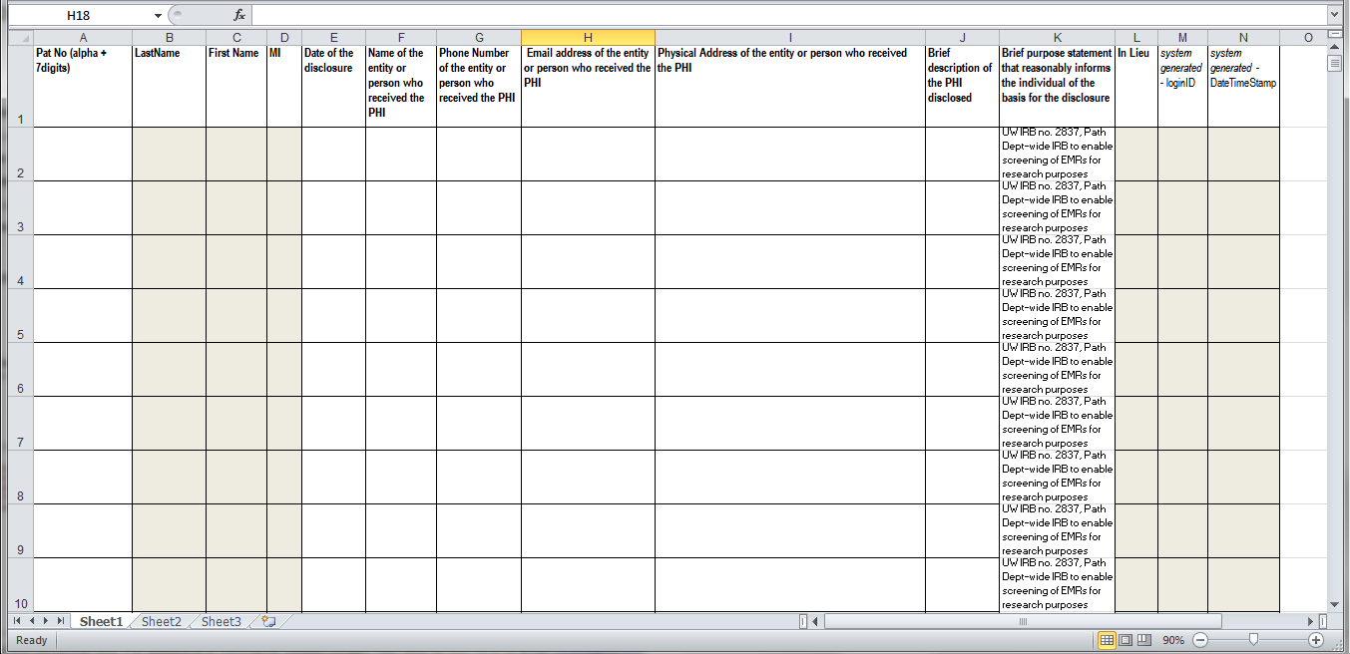
Fill in the white columns
Copy and paste
Patient Numbers
from your search
Your name
Your email
Your address
Date you did the search
Your phone no.
Ex: DOB, diagnosis code; note 600 character limit

Slide 15
When you write a paper based on data acquired under this IRB approval
Sample IRB approval language for the manuscript:
"Ethical approval: Human subjects research was approved by the University of Washington Institutional Review Board, IRB protocol no. 2837. Human subject activities were performed in accordance with the regulatory requirements laid down in U.S. Code of Federal Regulations, Title 45 Department of Health and Human Services Part 46, Protection of Human Subjects."

Slide 16
For more information
PI, David C Chhieng: dchhieng@uw.edu
Erica Jonlin: ejonlin@uw.edu
Regarding IRB issues
Eric Edwards: edward1e@uw.edu
Regarding PowerPath, medical records searches
http://www.pathology.washington.edu/resources/resources-for-faculty-staff
Instructions, blanket IRB application, HIPAA reporting

