Slide 1
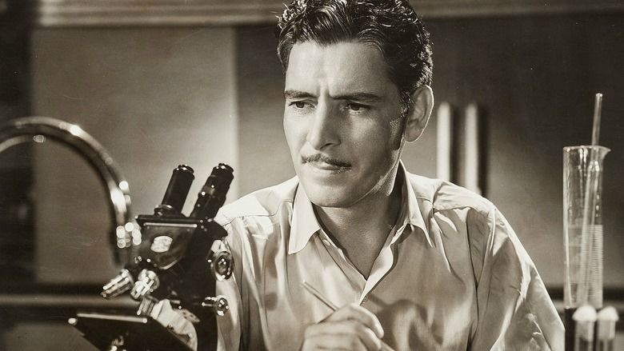
IRB Review of Research in the Department Pathology (now DLMP!)
Erica C. Jonlin, PhD
ejonlin@uw.edu
IRB Consultant
Department of Pathology
July 22, 2020

Slide 2
Institutional Review Boards (IRBs)
An Institutional Review Board (IRB) is a board, committee, or other group formally designated by an institution to review, to approve the initiation of, and to conduct periodic review of, research involving human subjects.
IRB review is a Federal requirement
IRB review must be conducted:
  by research institutions that receive Federal funds
  For FDA-regulated research
    For example, collection of data intended to support marketing of a diagnostic
IRBs review research involving human subjects, human specimens, human data

Slide 3
Purpose of IRB review
Ensure the protection of the rights and welfare of human subjects who are enrolled in research studies
Ensure the protection of the rights and welfare of human subjects whose specimens and/or medical information is used in research studies
Ensure that the benefits of the research outweigh the risks
Review and approve the consent form –
  Or decide if it is okay to waive consent

Slide 4
“The IRB”
University of Washington:
  The Human Subjects Division (HSD) – multiple IRBs
  For UW Pathology, they review:
    Clinical trials (e.g., intervention) and observational research studies that do not involve cancer
    Cancer-related studies that involve only medical records review and/or specimens
      That is, no contact with patients for research purposes
Cancer Consortium:
  The Fred Hutchinson Cancer Research Center Institutional Review Office (IRO) – multiple IRBs
  For Pathology, they review oncology clinical trials and other studies in which the investigators interact with the research participant
    For example, studies requiring informed consent to obtain a specimen
Most Pathology research is “minimal risk” and is reviewed by an administrator who works in the IRB office

Slide 5
Types of Pathology research studies that are reviewed by the IRB
Studies of tissue samples or other human specimens
  samples may or may not be anonymous
  Samples may have been collected for clinical care, or specifically for research purposes
Development of repositories of human samples for study of a particular disease
Development of registries of patients with a particular condition
Studies involving medical records review
  PowerPath
  Other UWMC, SCCA, HMC medical records systems
  Slide review
Technology development
Biomarker development

Slide 6

Even if your study does NOT involve interacting with human subjects, you will likely need an IRB application.
Do I need IRB review for studies on specimens and medical records?
Even if the materials you are studying are clinical specimens that you have encountered in your clinical practice, you will need to submit something* to the IRB to be able to use them for research purposes.
*there are different kinds of submissions

Slide 7
You are doing research if:
You are conducting a systematic investigation, including research development, testing, and/or evaluation, designed to develop or contribute to generalizable knowledge.
Do you plan to publish in a scholarly journal? If yes, it’s usually research*
Also: if you are developing a new test or diagnostic using human specimens/data you are doing research
*Quality Improvement activities generally are not research

Slide 8
Types of IRB Review for Specimens-Medical Records studies
“Expedited,” also know as “Minimal Risk” review
  “Minimal risk” means that the probability and magnitude of harm or discomfort anticipated in the research are not greater than those ordinarily encountered in daily life or during the performance of routine physical or psychological examinations or tests.
“Not Human Subjects” determination
“Exempt” determination
Only the IRB can decide if your study is “minimal risk” or “not human subjects research” or “exempt”

Slide 9
Research with specimens in the Department of Pathology: a typical pathway
Screen PowerPath to identify patients
Pick eligible cases
Request the specimens
(e.g., from NWBioTrust)
Stain the specimens for biomarker(s) of interest
Correlate patient data (e.g., EMRs over time) with biomarker data
Publish

Slide 10
Development of a new pathology method/device for diagnosis
Screen PowerPath to identify patients
Pick eligible cases
Request the specimens
(e.g., from NWBioTrust)
Compare standard of care method with investigational method
Correlate patient outcomes (e.g., EMRs over time) with 2 methodologies
Publish

Slide 11
A research study in the Department of Pathology: feasibility or pilot study
Screen PowerPath to identify patients
Pick eligible cases
Look at the archived slides
Use the data to plan a future study

Slide 12
Screening medical records and pathology slides for research purposes
You likely review patient records all the time, e.g.,
  PowerPath, EPIC, etc.
  Pathology slides
But if you want to review these records and materials for a RESEARCH study (not for clinical care), you must fulfill several requirements:
First: obtain permission from the UW Institutional Review Board (IRB) | The Dept. of Pathology has obtained approval of a “blanket IRB application.” If you are covered under this approval (discussed below), you may not have to do your own IRB application!
After screening the records/slides, report to UW Compliance which patient records you looked at (this is a HIPAA requirement). | Even if you qualify for the blanket IRB approval, you must do the HIPAA-required reporting!
More on this later . . .

Slide 13
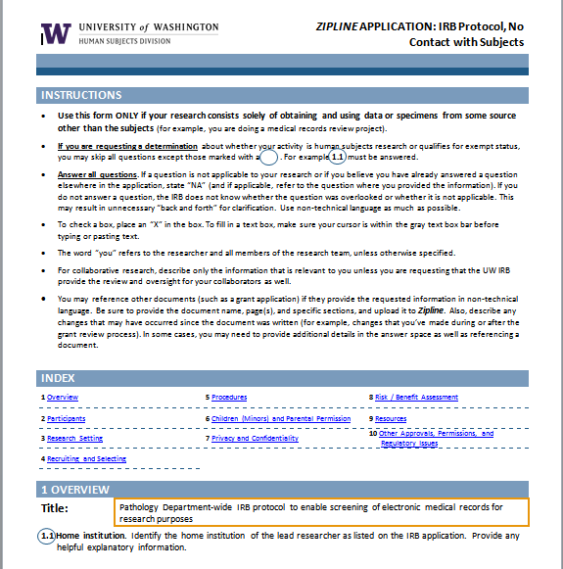
Typical IRB application in Pathology
Electronic form that you fill out and then upload

Slide 14
Key Questions
1.5 Objectives Using lay language, describe the purpose, specific aims, or objectives that will be met by this specific project. If hypotheses are being tested, describe them. You will be asked to describe the specific procedures in a later section.
1.6 Study design. Provide a one-sentence description of the general study design and/or type of methodology.
Your answer will help HSD in assigning applications to reviewers and in managing workload. Examples: a longitudinal observational study; web scraping from a convenience sample of blogs; medical record review; coordinating center for a multi-site study; genetic analyses of residual clinical specimens.

Slide 16
1.8 Supplements. Check all boxes that apply, to identify Supplements you should complete and upload to the Supporting Documents SmartForm in Zipline.
This section is here instead of at the end of the form to reduce the risk of duplicating information in this IRB Protocol form that you will need to provide in these Supplements.
 | Check all That Apply |  |  |  |  | Type of Research | Supplement Name
 |  |  |  |  |  | Department of Defense The research involves Department of Defense funding, facilities, data, or personnel. | ZIPLINE SUPPLEMENT: Department of Defense
 |  |  |  |  |  | Department of Energy The research involves Department of Energy funding, facilities, data, or personnel. | ZIPLINE SUPPLEMENT: Department of Energy
 |  |  |  |  |  | Genomic data sharing Genomic data are being collected and will be deposited in an external database (such as the NIH dbGaP database) for sharing with other researchers, and are you asking the UW to provide the required certification or to ensure that the consent forms can be certified | ZIPLINE SUPPLEMENT: Genomic Data Sharing
 |  |  |  |  |  | Medical device Procedures involve the use of any medical device, even if the device is not the focus of your research, except when the device is FDA-approved and is being used through a clinical facility in the manner for which it is approved | ZIPLINE SUPPLEMENT: Devices
 |  |  |  |  |  | Multi-site study You are asking the UW IRB to review one or more sites in a multi-site study. | ZIPLINE SUPPLEMENT: Participating Site in Multi-Site Research
 |  |  |  |  |  | None of the above

Slide 18
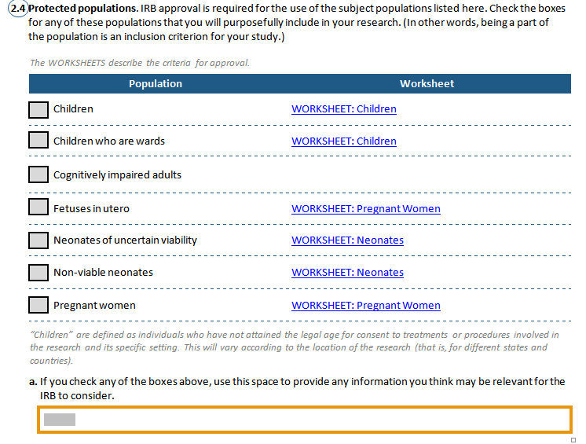

Slide 19
The IRB wants to know
Procedures for identifying and selecting subjects
  E.g., PowerPath or other medical record search
Data Sources
  E.g., medical records, slide review, specimen analysis
Clinical specimens? Leftover/residual? (Usually)
Or specimens obtained just for research purposes?
Giving research results to patients? (Usually NOT)
Getting consent? (Usually NOT, particularly when using existing specimens)

Slide 20
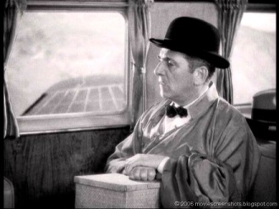
The IRB wants to know
  Specimens – from blocks
    One-time? Longitudinally?
    Collected retrospectively (they exist already)
    Collected prospectively (from future patients)
  Medical information
    One-time? Longitudinally?
    What information?
      For example: age at diagnosis, history of disease

Slide 21
Identifiability of specimens
Specimens/slides/imaging studies are NOT “anonymous” or “de-identified”
  if they have names or unique hospital numbers (e.g., U numbers) on them
  If You or your collaborator had/have direct interactions with subjects and/or have direct access to the subjects’ identities
Specimens may be considered “de-identified” if you obtain them from another researcher or a repository that has coded the specimens and WILL NOT provide you with any identifiers or the key to the code
  NOTE: The IRB considers the specimens “coded” rather “de-identified” if the researcher who provides the coded specimens (and who therefore can figure out the identifies) is involved in the research (e.g., data analysis)
You can do research on EITHER type of specimen. Either is fine; you just have to tell the IRB what you are doing.

Slide 22
Sources of specimens/information
A research repository
  GU Cancer Biorepository (Dr. Larry True)
  They can provide you with coded specimens and medical information
  You will have no access to identifying information
Pathology Department: NW BioTrust
  Clinical specimens
  They can also do a medical records search, and provide you with coded specimens and companion medical information

Slide 23
The IRB wants to know
Will you access, obtain, use, or disclose Protected Health Information (PHI)?
  Generally in research: we access and obtain PHI – but we do NOT disclose it
Genomic data sharing
  Are you doing any sequencing? Will you be uploading the sequence data to an online database (e.g., on dbGaP)?
Data and specimen sharing/banking
  Are you prospectively collecting specimens? Are you creating a repository? Will you share samples?
Future contact with subjects?
  For studies in which there are interactions with patients
  Give them clinically relevant results
  Tell them about other studies they may qualify for

Slide 24
Consenting issue: waiver of consent
Most research in Pathology can be done under “waiver of consent”
Consent can typically be waived for studies on preexisting clinical records (includes slides) and specimens (e.g., biopsies) obtained for clinical purposes/care
Criteria for waiver of consent:
The clinical investigation involves no more than minimal risk (as defined by regulations) to the subjects;
The waiver will not adversely affect the rights and welfare of the subjects;
The clinical investigation could not practicably be carried out without the waiver; and
Whenever appropriate, the subjects will be provided with additional pertinent information after participation.

Slide 25
Consenting issue: waiver of consent
    Generally, for studies involving hundreds of specimens/records, we can reasonably explain that consenting is “impracticable”
    The results of the research study will not be used to direct care
    The results of the research study cannot be used to direct care (e.g., basic research in which the implications are not fully known)

Slide 26
The IRB wants to know
Also of interest
  Are you on a commercialization pathway?
    Developing a device?
    Is there a start-up company involved?
    Any financial or other conflict of interest?
  What is the source of funding?
  Who are the collaborators?

Slide 27
What are the risks of Pathology research studies to the subjects?
Risk of breach of confidentiality
  i.e., disclosure of patient identity
    From not keeping patient privacy
    From DNA sequencing
Discover something about the patient that would not otherwise be known
Would you provide results to the research subjects?
  Should you provide results to the subjects? Why or why not?
  Generally, these studies are “basic research” and therefore do NOT return results to patients

Slide 28
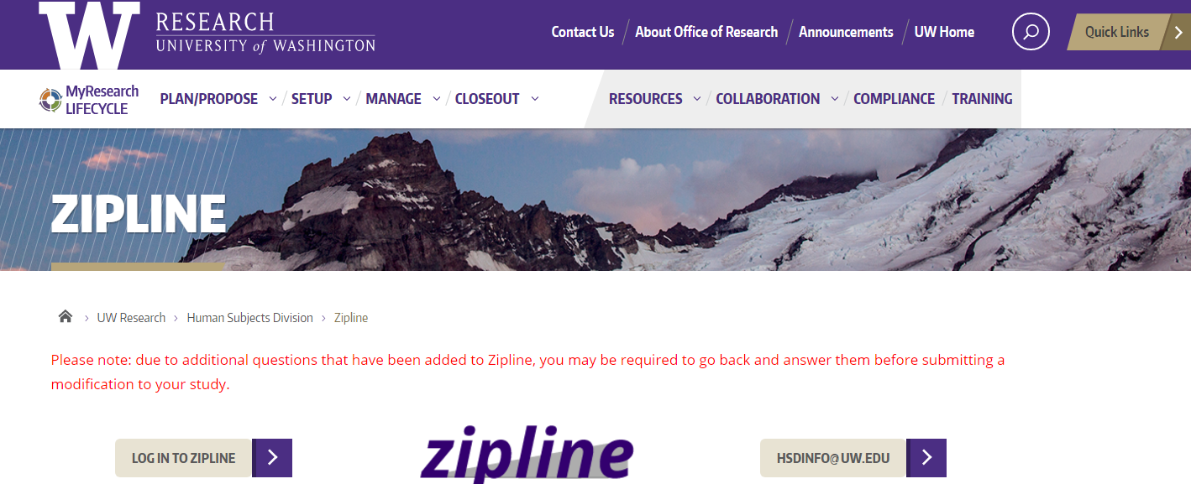
Zipline
The system the UW Human Subjects Division uses to review IRB applications
https://www.washington.edu/research/hsd/zipline/

Slide 29
The Pathology Department has a department-wide IRB application!
PI, David C Chhieng: dchhieng@uw.edu

Slide 30

UMBRELLA/Blanket IRB APPLICATION
Screen PowerPath to identify patients
Pick eligible cases
Look at the archived slides
Analysis and/or
use this information to plan a future study

Slide 31
Pathology Department
Approved Umbrella or “Blanket IRB”
PURPOSE:
Enables Pathology Department members to:
screen electronic medical records (primarily the Department database, PowerPath, but also EPIC, other UW medical records) and, if necessary,
view archival histology and cytology slides for research purposes
Activities which may be conducted under this blanket IRB application include:
1) Conducting a records review study, or
2) Determining feasibility for a future study (for example, whether there are enough patients), or
3) Establishing a study dataset for a future study of both records and specimens.

Slide 32
And then . . .
You would fill out your own IRB application for a follow-up study that involves obtaining specimen blocks in order to cut and study new sections
  Definitely needed if you have your own grant (i.e., not Departmental research funds)

Slide 33
“Blanket IRB”
PI: Dr. David Chhieng
IRB no. 2837
Requirements:
  You are screening PowerPath or other medical records, and reviewing clinical slides, for research purposes
  You have signed the Letter of Agreement to do HIPAA required accounting (described below)
  You have completed your HIPAA training

Slide 34
You cannot use the Blanket IRB
if:
  You have a grant or other non-departmental funding specifically for the research project for which you are screening records
  You have a Financial Conflict of Interest and a management plan associated with it
  You want to pull specimens and cut new sections for staining
In these cases, you need your own IRB application
  I can help you write it!

Slide 35
The Deadly
HIPAA

Slide 36
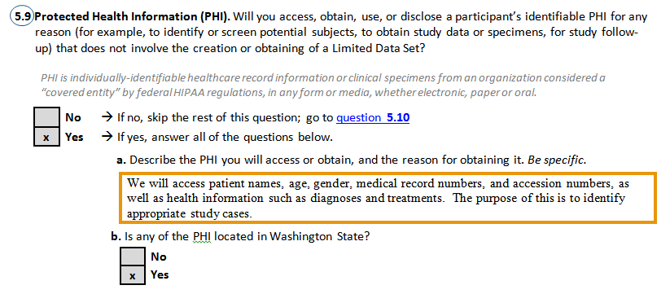
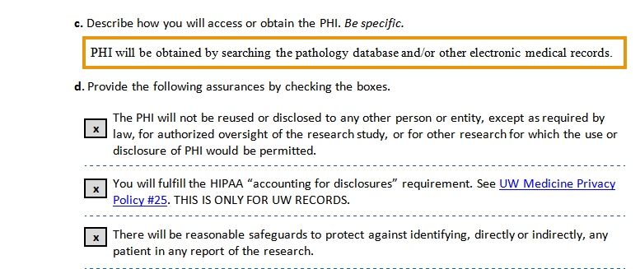
WHAT YOU AGREE TO DO WHEN YOU SEE PHI FOR RESEARCH
From the IRB protocol:

Slide 37
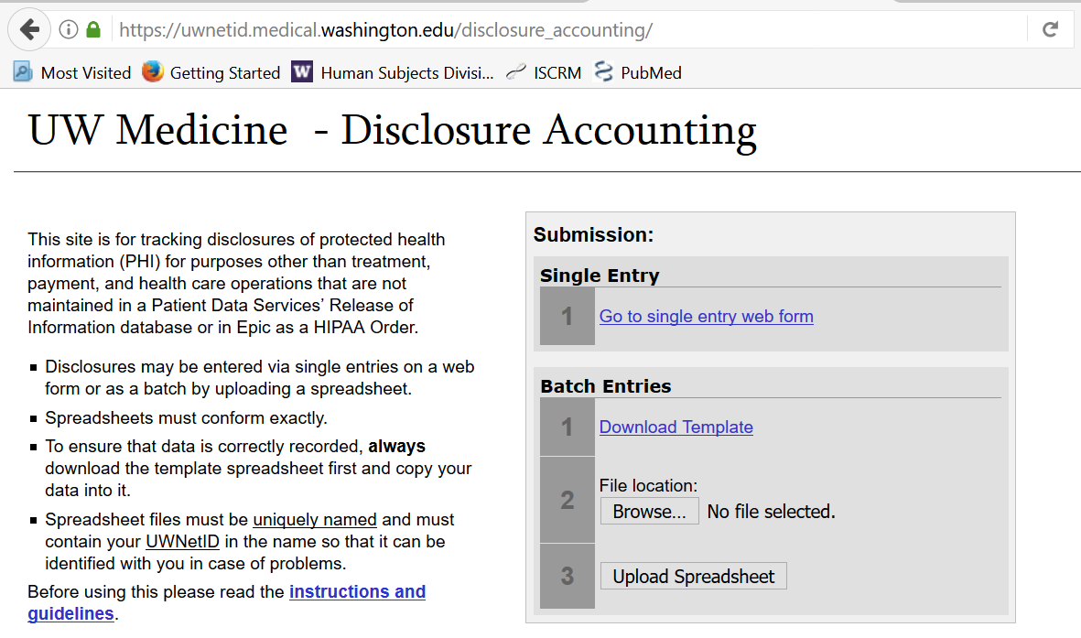
By signing the Path Department Blanket IRB Letter of Agreement,
You are an investigator on this IRB application AND
YOU HAVE PROMISED TO REPORT TO UW COMPLIANCE WHICH PATIENT RECORDS YOU LOOKED AT FOR RESEARCH PURPOSES
(HIPAA “Accounting for Disclosures” requirement)

Slide 38
Searching medical records and reporting which patient records you reviewed
“Accounting for Disclosures”
Do your search (typically PowerPath, but also applies to any electronic medical records in our system)
Get your list of patient numbers
Fill out the UW Medicine HIPAA Compliance Excel spreadsheet (specific spreadsheet below)
Save the Excel spreadsheet with a name like this: “yournetIDdateofsearch” - for example: ejonlin22Feb2020
Log into the UW Medicine SSLVPN with AMC login credentials: https://sslvpn.medical.washington.edu/dana-na/auth/url_9/welcome.cgi

Slide 39
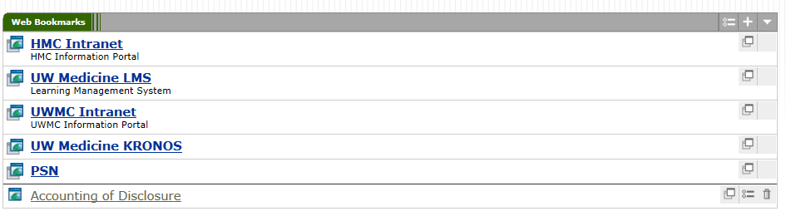
Accounting for Disclosures
Add the disclosure accounting website link to the Web Bookmarks after logging in (the + icon in the top right of the photo below):
https://disclosureaccounting.uwmedicine.org/
Once it’s added you should be able to get to the disclosure accounting site through the bookmark.
Upload your Excel spreadsheet
Also send the Excel spreadsheet to Dr. Chhieng dchhieng@uw.edu and Erica Jonlin ejonlin@uw.edu

Slide 40
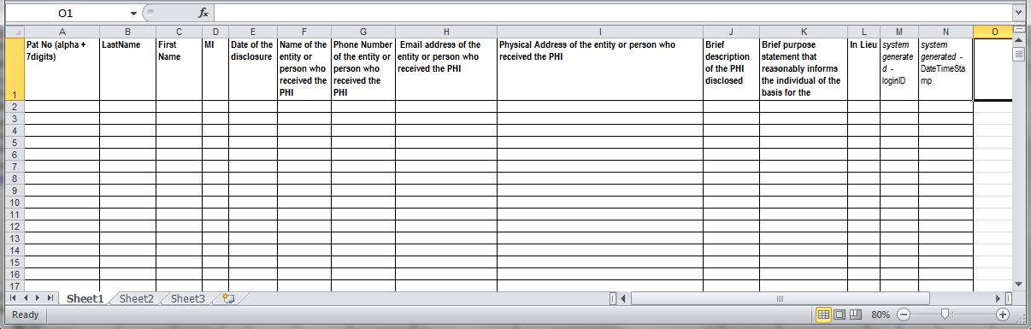
The Excel Spreadsheet that you fill out after doing a records search:
UW Medicine Compliance Form
*
Your name
Your address
**
Leave these BLANK
Your email
Leave these BLANK
Date you did the search
Ex: DOB, diagnosis code; note 600 character limit
Your phone no.
Copy and paste this exact same information in every row for which you have a patient no. in Column A
* Fill in each and every patient number that came up in your search, one per row.
Each patient number will start with U, H, N, or Z, and will be followed by 7 digits.
** Write: “UW IRB no. 2837, Path Dept-wide IRB to enable screening of EMRs for research purposes”

Slide 41
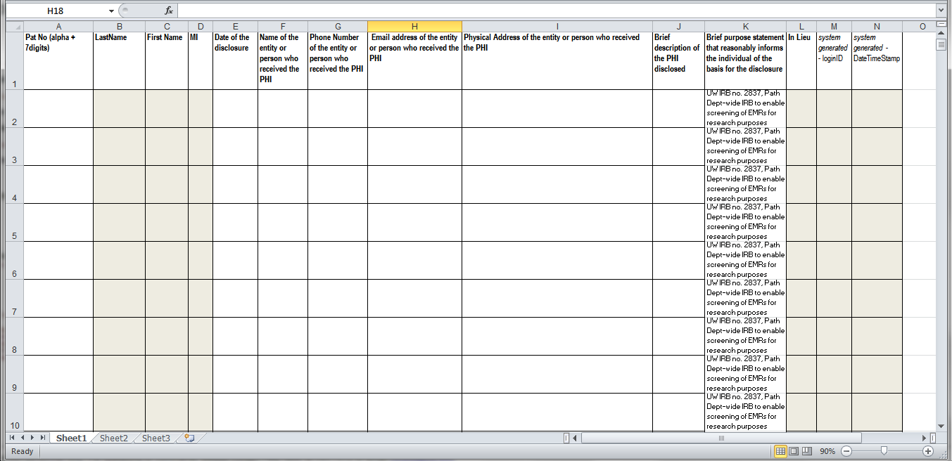
I made it easy for you - fill in the white columns
Copy and paste
Patient Numbers
from your search
Your name
Your email
Your address
Date you did the search
Your phone no.
Ex: DOB, diagnosis code; note 600 character limit

Slide 42
When you write a paper based on data acquired under the Blanket IRB approval
Sample IRB approval language for the manuscript:
"Ethical approval: Human subjects research was approved by the University of Washington Institutional Review Board, IRB protocol no. 2837. Human subject activities were performed in accordance with the regulatory requirements laid down in U.S. Code of Federal Regulations, Title 45 Department of Health and Human Services Part 46, Protection of Human Subjects."

Slide 43
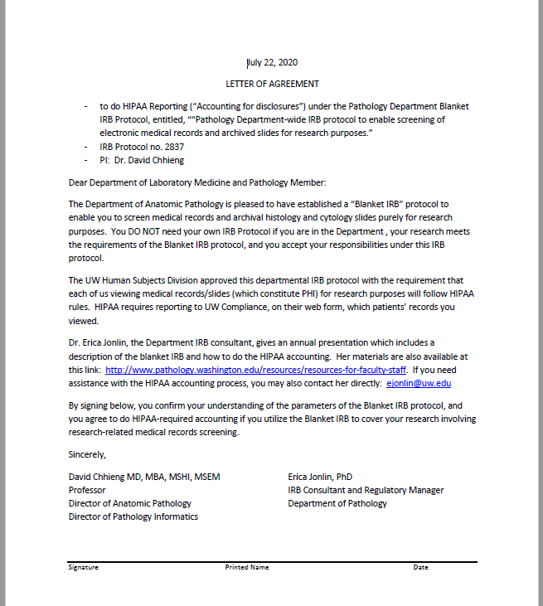
Letter of Agreement
Email Erica to get a copy
Sign it
Email the pdf back to Erica
Then you’re part of the Blanket IRB!
ejonlin@uw.edu

Slide 44

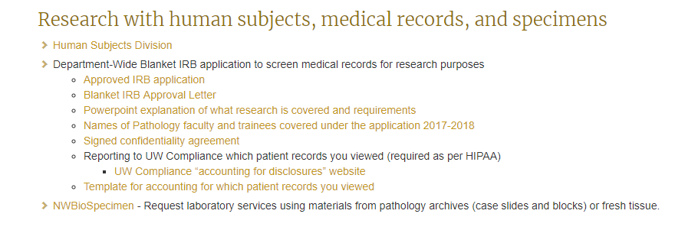
Your Go-To Website in Pathology http://www.pathology.washington.edu/resources/resources-for-faculty-staff
Scroll down to here
This will be updated

Slide 45

What I can do for you!
Answer questions
  In person
  On the phone
  By email
Help you design your IRB application
Review your IRB application
(or even DO your IRB application)
Help you upload your IRB application to Zipline and answer the IRB’s questions
Recommend resources
Tell you about human subjects training, Cancer Consortium requirements
Erica Jonlin
ejonlin@uw.edu

Slide 46
For more information
Erica Jonlin: ejonlin@uw.edu
  Regarding IRB issues
http://www.pathology.washington.edu/resources/resources-for-faculty-staff
  Instructions, blanket IRB application, HIPAA reporting
Other useful references
  UW Human Subjects Division (UW IRB)
    https://www.washington.edu/research/hsd
  FHCRC Institutional Review Office (Cancer Consortium IRB)
    http://extranet.fhcrc.org/EN/sections/iro/
  Cancer Consortium
    http://www.cancerconsortium.org/en.html

